Slide 1
Life Expectancy
Group 12
Xuehan Chen, Samiran Ghosh Roy, Harper He, Tianxing Hu, Christy Sato

Slide 2
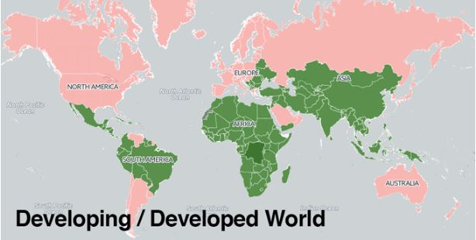
Introduction
This data consists of developed and developing countries with a varying degree of life expectancy which is dependent on various factors which we try to determine using our analysis techniques.This project will help in suggesting a country which area should be given importance in order to improve the life expectancy of its population

Slide 3
Content
Part A:
Objectives
Data Source
Variable Descriptions
Descriptive Statistics
Findings
Part B:
Correlation matrix
Scatterplots
Multiple regression
Hypothesis testing

Slide 4
Part A
Descriptive Analysis of Our Variables

Slide 5
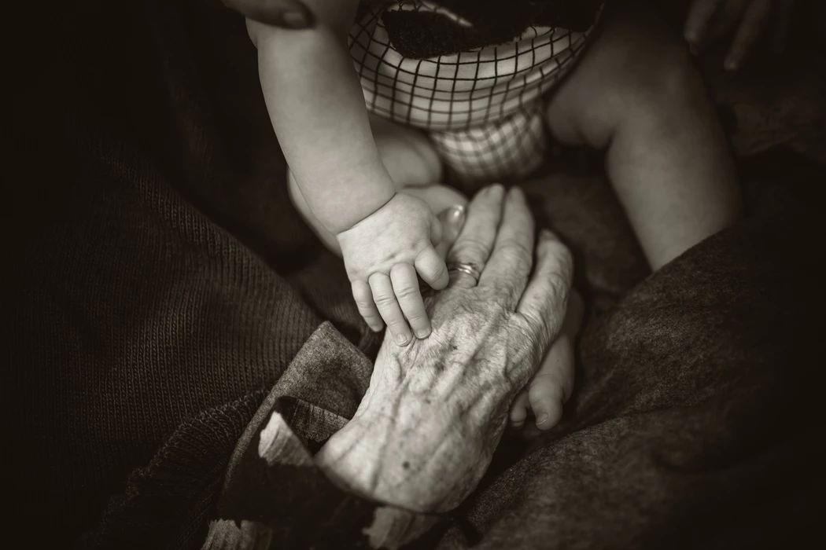
Objectives:
The objective of this part is to understand the statistics of our variables so that we may shed more light on which variables we analyzed further and to determine which variables might be helpful in determining/predicting Life Expectancy.

Slide 6

Data Source:
The dataset related to life expectancy, health factors for 184 countries has been collected from the same World Health Organization (WHO) data repository website and its corresponding economic data was collected from United Nation website. In this project, we focus on the data on 2000 and 2015 for 184 countries for economic, mortality and other health related analysis.
Data Source:
https://www.who.int/
https://www.kaggle.com
https://data.worldbank.org

Slide 7
Description of Variables
Variable | Data Type | Description
Country | Qualitative | Name of countries
Year | Quantitative | Year of data
Status | Qualitative | Developed/Developing country
Life Expectancy | Quantitative | Life expectancy in age
Adult Mortality | Quantitative | Adult mortality rates of both sexes (probability of dying between 15-60 years per 1000 population)
Alcohol | Quantitative | Recorded per capita (15+) consumption (in litres of pure alcohol)
Percentage Expenditure | Quantitative | Expenditure on health as a percentage of GDP per capita (%)
BMI | Quantitative | Average Body Mass Index of entire population
Polio | Quantitative | Polio immunization coverage among 1 year olds (%)
Notes:
18 variables
368 observations

Slide 8
Variable | Data Type | Description
Total Expenditure | Quantitative | General government expenditure on health as a percentage of total government expenditure (%)
Diphtheria | Quantitative | Diphtheria tetanus toxoid and pertussis (DTP3) immunization coverage among 1 year olds (%)
GDP | Quantitative | Gross Domestic Product per capita (in USD)
Population | Quantitative | Population of the country
Schooling | Quantitative | Number of years of schooling (years)
Smoking Prevalence | Quantitative | The percentage of men & women ages 15+ who currently smoke any tobacco product on a daily/non-daily basis.
CHE per capita | Quantitative | Current Health expendicture per capita (in USD)
CHE as percentage of GDP | Quantitative | Current health expenditure (CHE) as percentage of gross domestic product (%)
GGHE-D as percentage of GGE | Quantitative | Domestic general government health expenditure as percentage of general government expenditure (%)
Notes:
What is your population of interest? Do you think your sample is a random sample?

Slide 9
About Data
Population of Interest: The population of interest is Life Expectancy data for 184 countries taken in the year 2000 and 2015.
Our sample is not a random sample, it is two samples, one taken from the year 2000 and one taken from the year 2015 for all countries, which would mean data of 184 countries for the year 2000 & 184 countries for the year 2015.
This is representative of our Population of Interest.

Slide 10
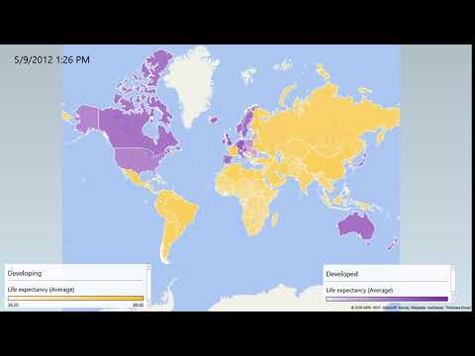
Variable Description- Life Expectancy(Time Series Map)

Slide 11
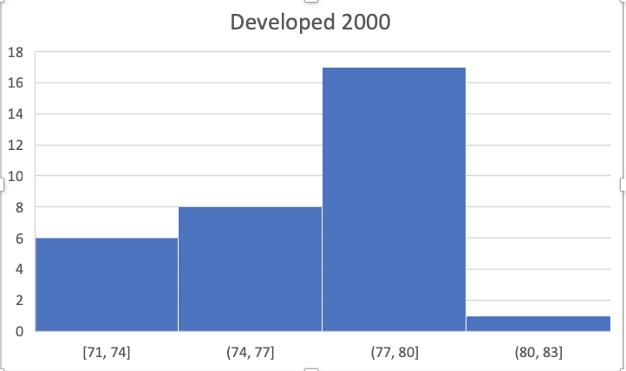
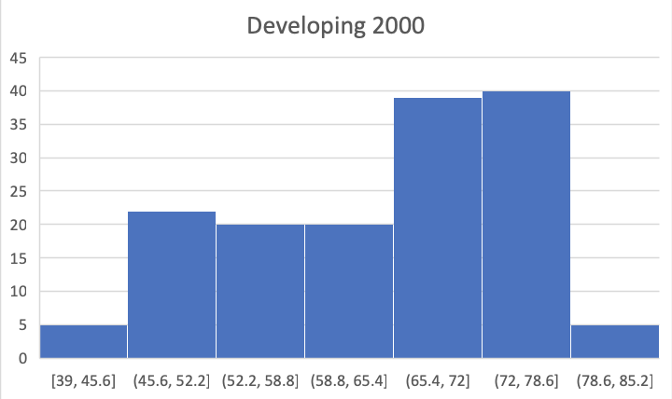
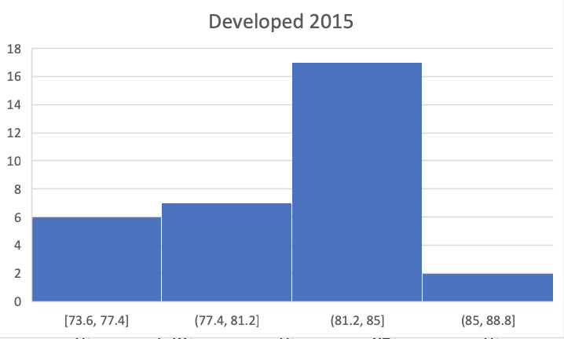
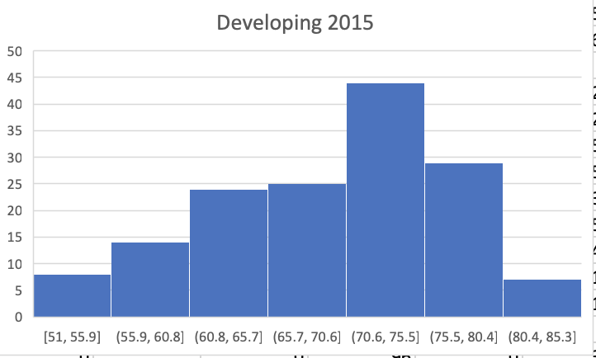
Life Expectancy
From map and histogram:
The median and mean of life expectancy on developed countries are higher than developing countries
The range of developing countries is larger than developed countries

Slide 12
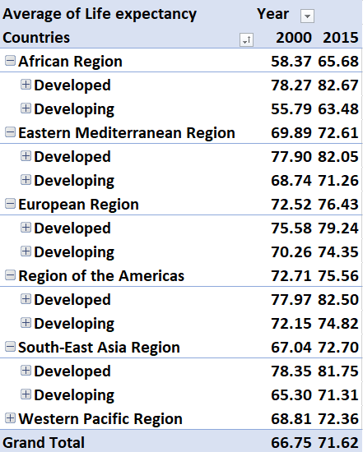
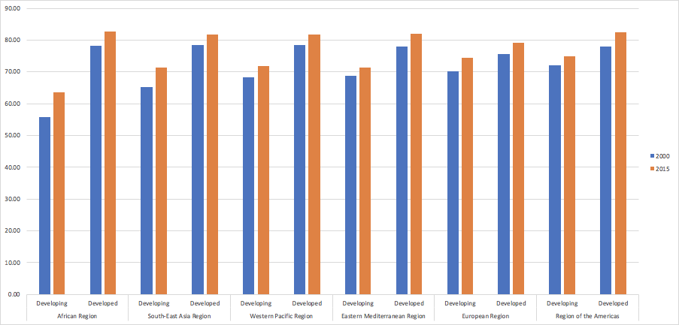
Variable Description- Life Expectancy(Pivot charts/tables)
Notes:
This pivot chart shows that irrespective of the region of the country the Life expectancy is always higher in 2015 than it is in 2000 and also that even in 2000, developed countries had higher average life expectancy than developing countries.

Slide 13
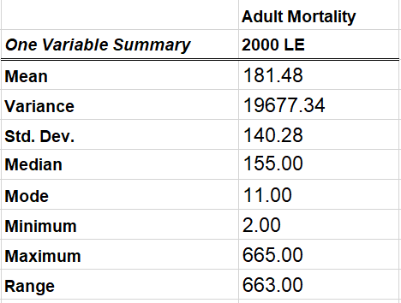
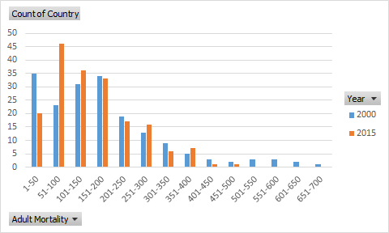
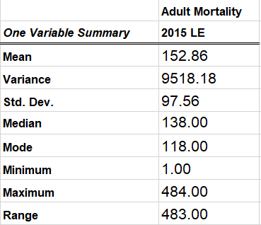
Variable Description- Adult Mortality
Notes:
Adult Mortality is a variable strongly negative-related to life expectancy. So we describe this variable and use simple linear regression to check the relationship between them.
The distribution of Adult Mortality is right-skewed. Good news is that it is decreasing.

Slide 14
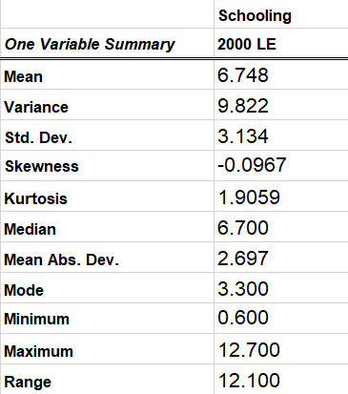
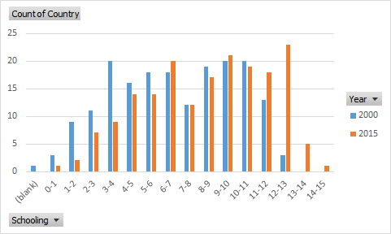
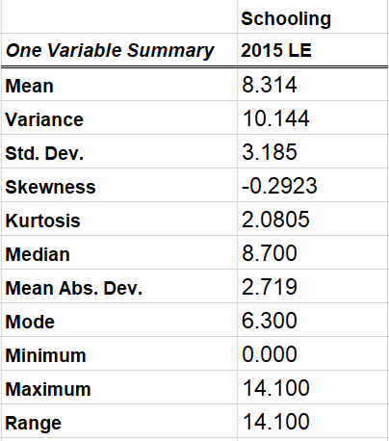
Variable Description- Schooling
Notes:
Schooling is a variable strongly positive-related to life expetancy. So we describe this variable and use simple linear regression to check the relationship between them.
The average value of Schooling is increasing from 2000 to 2015.

Slide 15
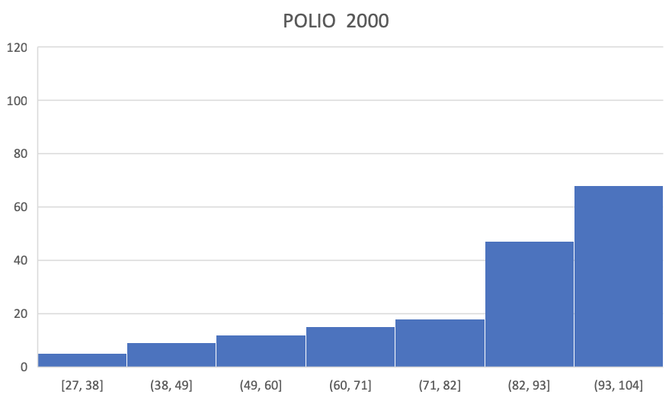
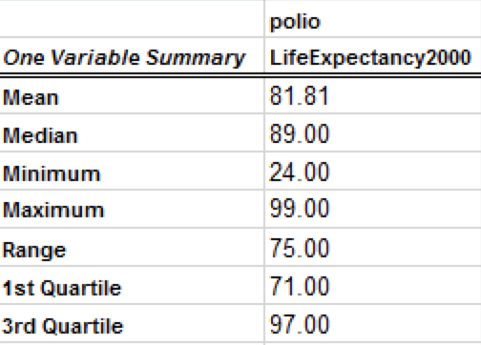
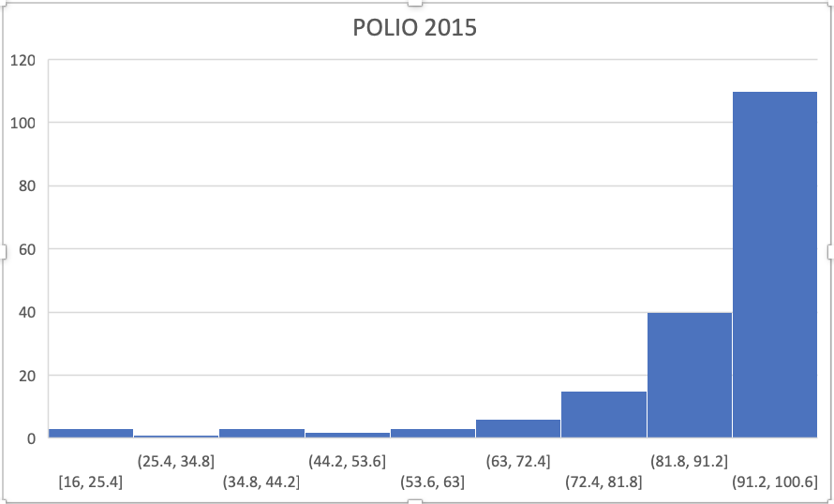
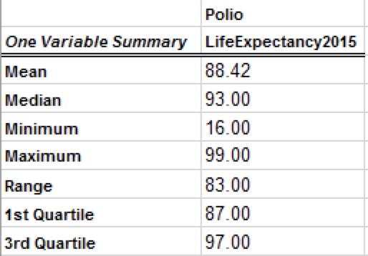
Variable Description- Polio Immunization among 1 year olds (%)

Slide 16
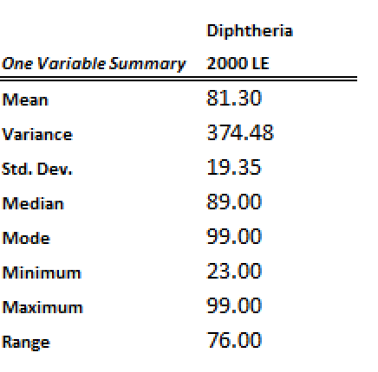
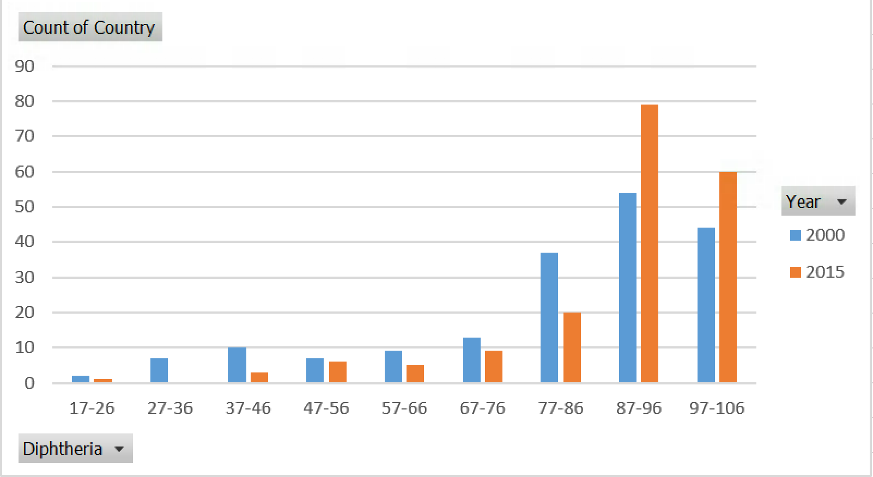
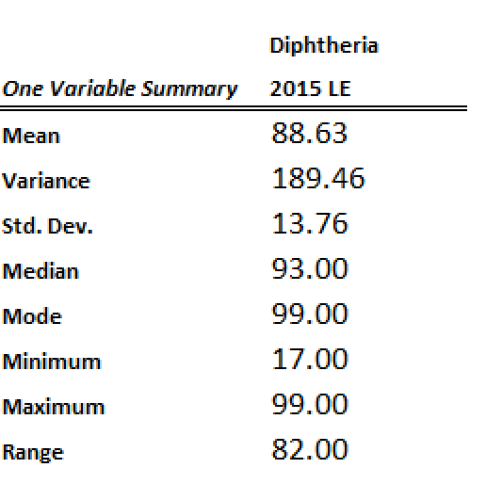
Variable Description- Diphtheria
Notes:
Diphtheria is a variable strongly positive-related to life expectancy. So we describe this variable and use simple linear regression to check the relationship between them.
The average value of Schooling is increasing from 2000 to 2015.

Slide 17
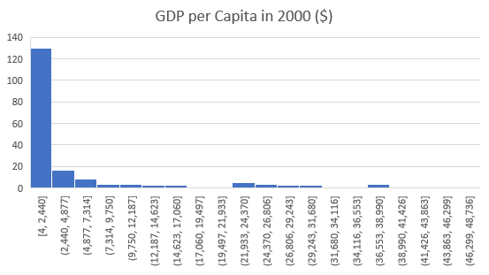
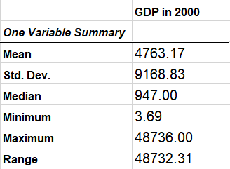
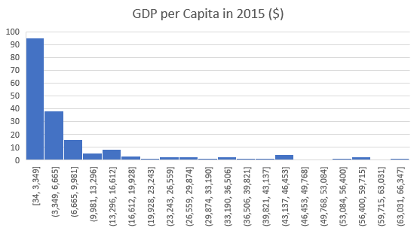
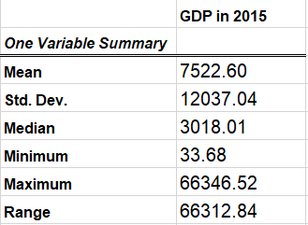
Variable Description - GDP

Slide 18
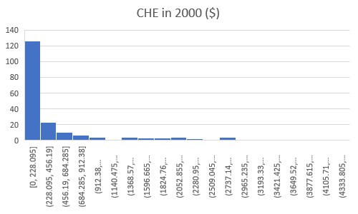
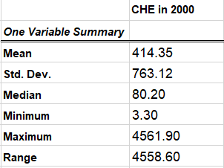
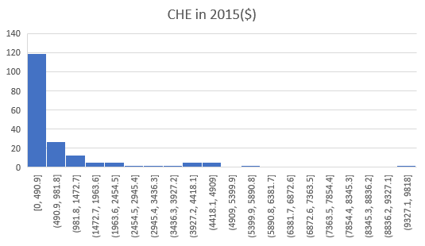
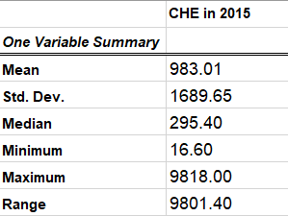
Variable Description - Current health expenditure (CHE) per capita

Slide 19
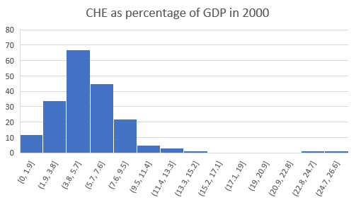
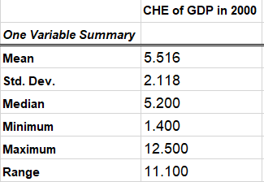
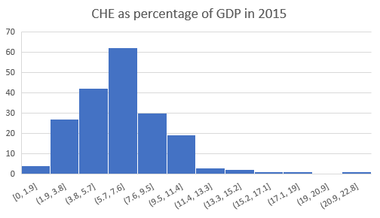
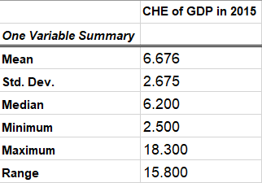
Variable Description - Current health expenditure (CHE) as percentage of gross domestic product (GDP) (%)

Slide 20
Findings
Life expectancy of both developing and developed countries has increased in the 15 years, and developing countries’ progress is more outstanding.
Governments’ financial investment to health and immunization coverage has improved in the 15 years.
Adult mortality rates were on the drop.
More and more countries’ BMI lies within the Normal weight(18.5–24.9) range.
Schooling was on increase means education coverage is improving.

Slide 21
Part B

Slide 22
Objectives
Analyzing the related variables for life expectancy.
Correlation matrix
Scatterplots
Multiple regression
Hypothesis testing

Slide 23
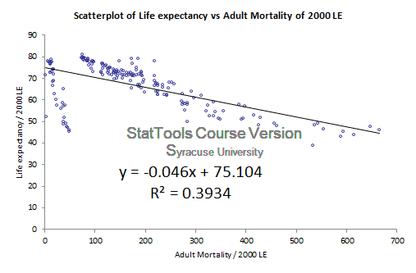
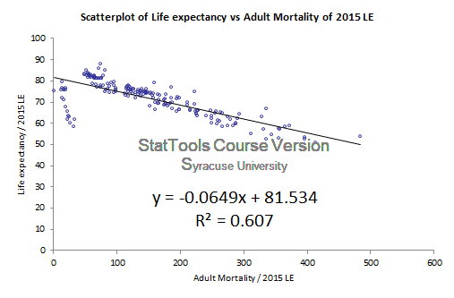
Simple Linear Regression - Life Expectancy vs. Adult Mortality

Slide 24
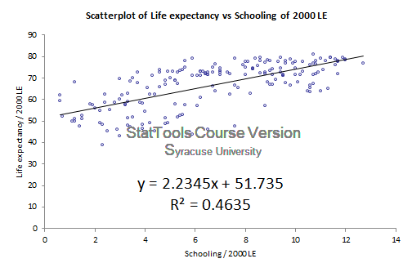
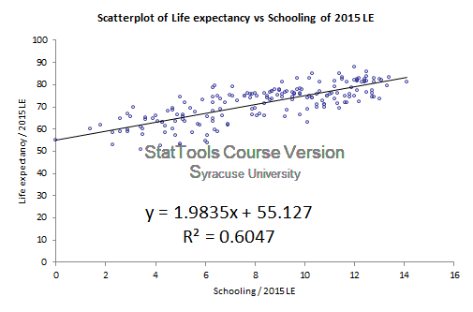
Simple Linear Regression - Life Expectancy vs. Schooling
Notes:
The relationship between Life Expectancy vs. Schooling is more strong than our expectation. Our assumption is that the longer the Number of years of schooling (years), the longer the Life Expectancy. But schooling will not be a strong predictor to Life Expectancy.
But the models with a 0.47 and 0.60 R-square indicate that schooling has a strong positive effect on Life Expectancy.

Slide 25
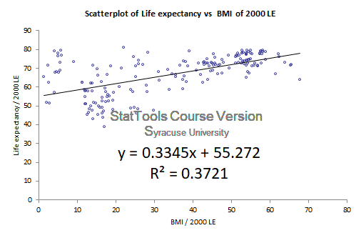
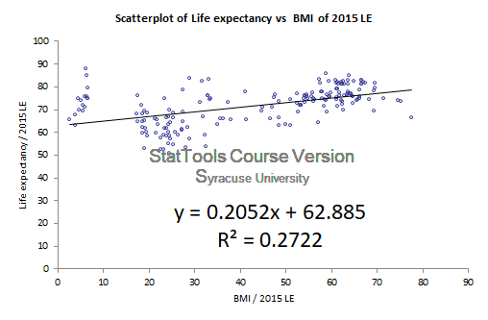
Simple Linear Regression - Life Expectancy vs. BMI
Notes:
The relationship between Life Expectancy vs. BMI is not within our expectation. Because as BMI increases, so does the risk for some diseases. The BMI should be in a certain range. So we expect their relationship to be nonlinear but it looks like. We will figure it out in the following multiple regression analysis

Slide 26
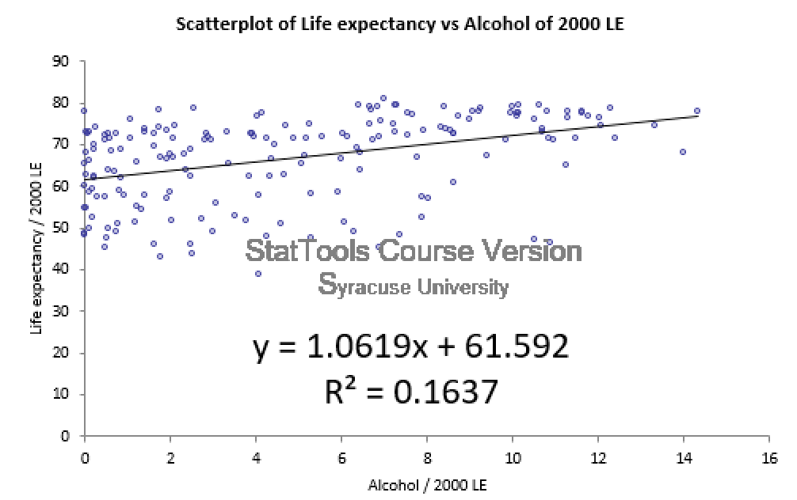
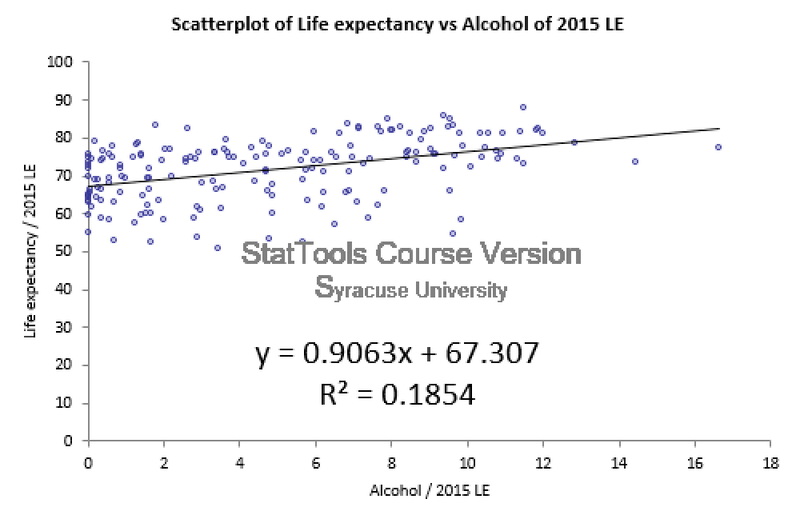
Simple Linear Regression - Life Expectancy vs. Alcohol
Notes:
The relationship between Life Expectancy vs. Alcohol is contrary to our expection. Our assumption is that the alcohol will negatively affect the Life Expectancy.
Although their relationship is not strong, it shows the for every additional liter alcohol consumption will increase life Expectancy by 1.0 and 0.9 respectively in 2000 and 2015

Slide 27
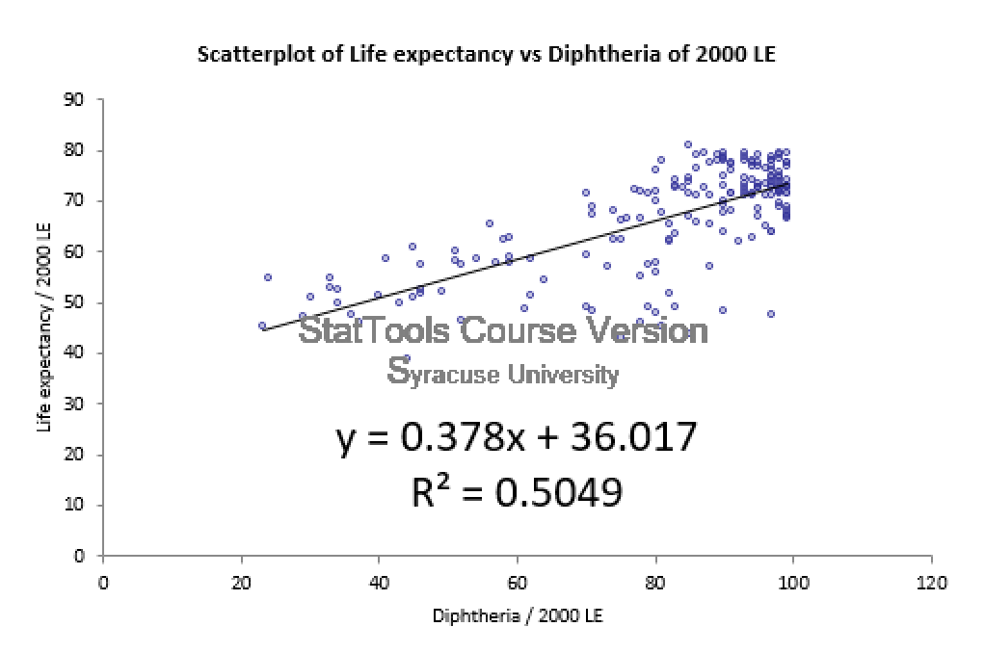
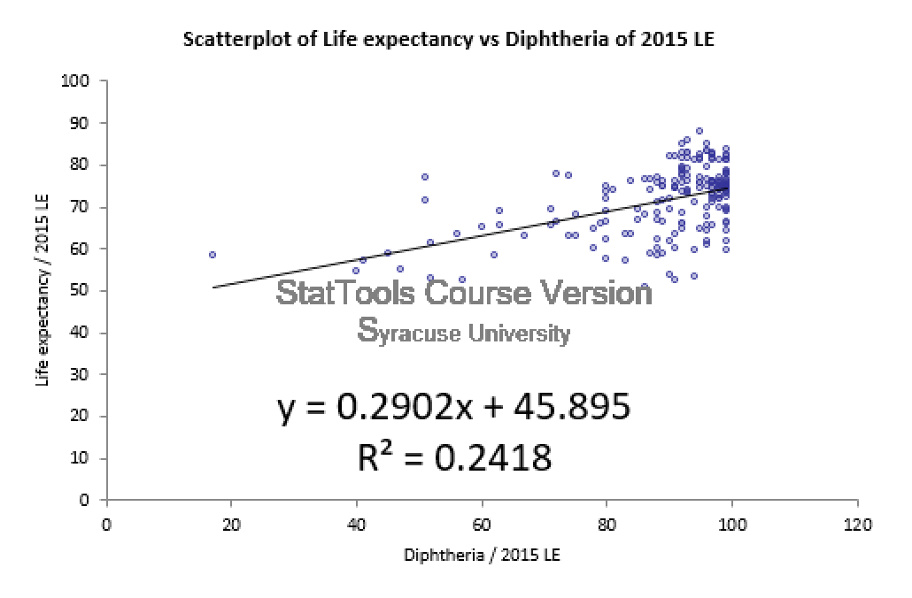
Simple Linear Regression - Life Expectancy vs. Diphtheria

Slide 28
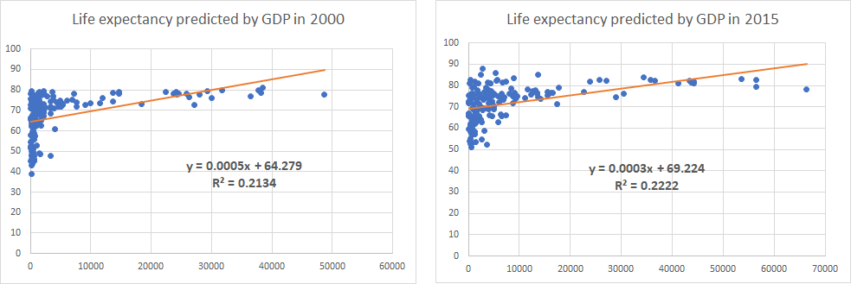
Simple Linear Regression - Life Expectancy vs. GDP

Slide 29
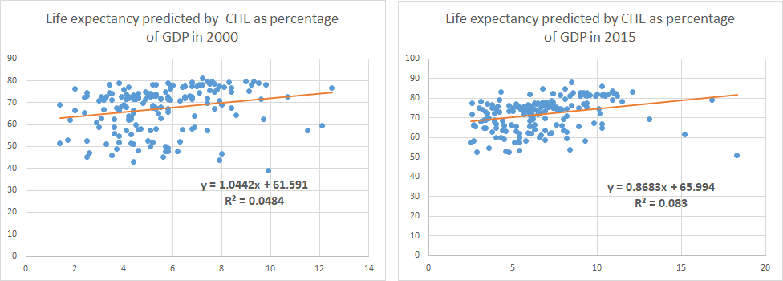
Simple Linear Regression - Life Expectancy vs. CHE of GDP

Slide 30
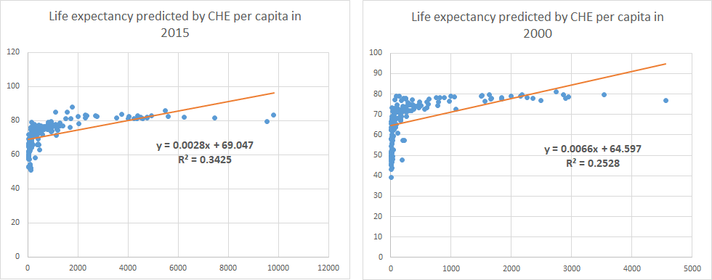
Simple Linear Regression - Life Expectancy vs. CHE

Slide 31
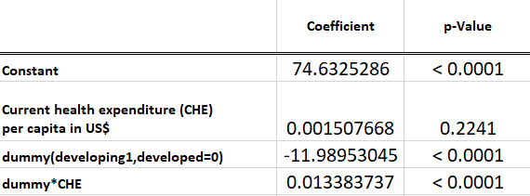
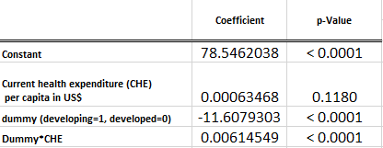
Multiple Linear Regression - Life Expectancy vs. CHE & Country status
2000
2015
Life expectancy= 74.63+0.0.001508*CHE - 11.99*Developing -0.01338*CHE *Developing
Life expectancy= 78.54+0.0.0006347*CHE - 11.61*Developing -0.006145*CHE *Developing
Adjusted R-square= 0.3684
Adjusted R-square= 0.5052

Slide 32
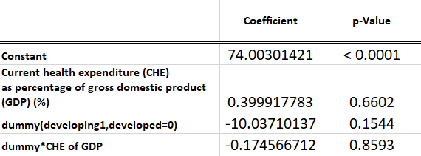

Multiple Linear Regression - Life Expectancy vs. CHE of GDP
2000
2015
Life expectancy= 74.00+0.3999*(CHE of GDP) -10.04*Developing-0.1746*(CHE of GDP)*Developing
Life expectancy= 76.37+0.4952*(CHE of GDP) -8.12*Developing-0.2517*(CHE of GDP)*Developing
Adjusted R-square= 0.2000
Adjusted R-square= 0.2794

Slide 33

Correlation Matrix - Year 2000
GGHE-D as percentage of GGE
CHE as percentage of GDP)
Percentage Expenditure
CHE per capita in US$
Life Expectancy
Total Expenditure
Smoking Prevelance
Adult Mortality
Diphtheria
Population
Schooling
Alcohol
BMI
Polio
GDP
Correlation Matrix of Variables Highlighting with a ±0.5 Interval, the highlighted variables are strongly Correlated with Life Expectancy
For the Year 2000
This does not imply causality but shows us that diphtheria along with BMI, Polio, Schooling and Per Capita earning are highly correlated with Life Expectancy.

Slide 34

Correlation Matrix - Year 2015
GGHE-D as percentage of GGE
Percentage Expenditure
CHE per capita in US$
CHE as percentage of GDP)
Life Expectancy
Total Expenditure
Smoking Prevelance
Adult Mortality
Diphtheria
Population
Schooling
Alcohol
BMI
Polio
GDP
For the year 2015, this correlation matrix shows that Diphtheria is no longer highly correlated with Life Expectancy if we consider a 士0.5 interval. Which can be tested further using our regression models.

Slide 35

Stepwise Linear Multiple Regression (2000) - without dummy and interaction variables
Life expectancy=46.3 - 0.029(Adult Mortality) + 0.070(BMI) + 0.549(polio) + 0.171(Diphtheria) + 0.722(Schooling)
Notes:
above is the equation for predicting life expectancy. For every additional year of schooling the life expectancy increases by a factor of 0.722.

Slide 36

Stepwise Linear Multiple Regression with dummy(2000)
Developed : Life expectancy= 64.54 - 0.047(Adult Mortality) + 0.08(BMI) + 0.11(polio) + 4.45
Developing : Life expectancy= 64.54 - 0.047(Adult Mortality) + 0.08(BMI) + 0.11(polio)
Holding other variables constant, the life expectancy of developed countries are higher than developing countries by 4.45 year.

Slide 37

Stepwise Linear Multiple Regression (2000) -
with dummy and interaction variables
Developed: Life expectancy= 95.09 - 0.19(Diphtheria)
Developing: Life expectancy= 37.8 + 0.34(Diphtheria)
Notes:
Each Diphtheria percent tends to increase the life expectancy of developing countries by 0.34 year but decrease life expectancy of developed countries by 0.19 year.

Slide 38

Stepwise Linear Multiple Regression (2015) - without dummy and interaction variables
Life expectancy=66.8- 0.042(Adult Mortality) + 0.028(BMI) + 1.206(Schooling)

Slide 39

Stepwise Linear Multiple Regression (2015) -
with dummy and interaction variables
Developed: Life expectancy= 85.69 - 0.07(Adult Mortality)
Developing: Life expectancy=79.13- 0.066(Adult Mortality)
Notes:
Each Adult Mortality rate tends to decrease the life expectancy of developing countries by 0.06 year but decrease life expectancy of developed countries by 0.87 year more than for developing countries by only 0.34 year.

Slide 40

Hypothesis
• P values < alpha values
• Null hypothesis is rejected
• Mean Life expectancy (2015) > Mean Life expectancy (2000)

Slide 41

Z- score transformation linear model (2000)

Slide 42

Z- score transformation linear model (2015)

Slide 43
Conclusions
The life expectancy has positive relationship with immunization coverage,Number of years of schooling, BMI and current health expenditure.
The life expectancy has negative relationship with adult mortality.
Status of a country is good at determining life expectancy. Especially when used as a dummy variable.

Slide 44
Thank you!

